Slide 1
Breeds of Companion Animals: Dogs
Notes:
1

Slide 2
Dogs
Are categorized into the following breed groups:
herding
working
hound
sporting
non-sporting
terrier
toy
Notes:
2

Slide 3
Herding Dogs
Breeds of Companion Animals: Dogs

Slide 4
Herding Dogs
Are born with the instinct to control the movement of animals
Include the following breeds:
Australian Cattle Dog (Blue or Red Heeler)
Australian Shepherd
Border Collie
German Shepherd
Old English Sheepdog
Pyrenean Shepard
Welsh Corgi, Cardigan
Welsh Corgi, Pembroke
Notes:
4

Slide 5
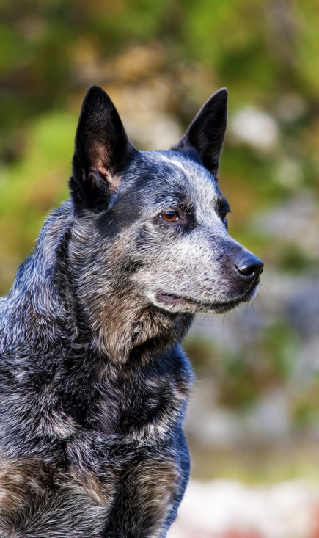
Australian Cattle Dogs
Weigh 35 to 45 pounds and measure 46 to 51 inches tall
Grow short to medium length straight hair which can be blue, blue merle or red merle in color
Are born white and gain their color within a few weeks
Notes:
5

Slide 6
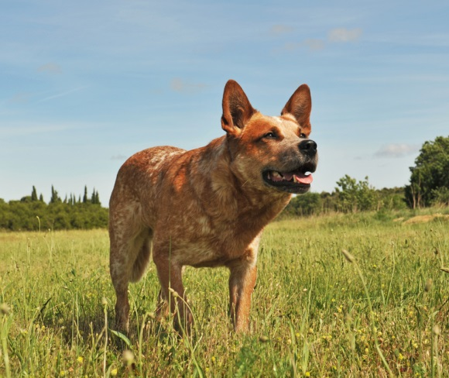
Australian Cattle Dog Behavior
Is characterized by the following:
alert
devoted
intelligent
loyal
powerful
affectionate
protective of family, home and territory
generally not social with other pets
Notes:
6

Slide 7
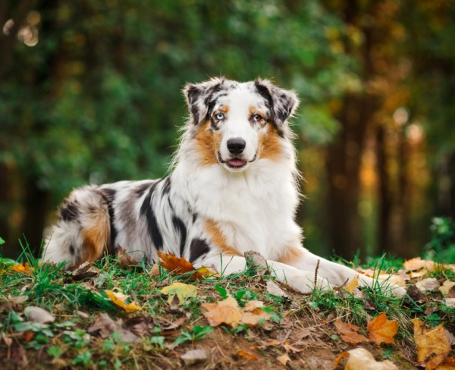
Australian Shepherds
Males weigh 50 to 65 pounds and measure 20 to 23 inches in height
Females weigh 40 to 55 pounds and measure 18 to 21 inches in height
Grow moderate length hair which can be black, blue merle, red or red merle in color
Notes:
7

Slide 8
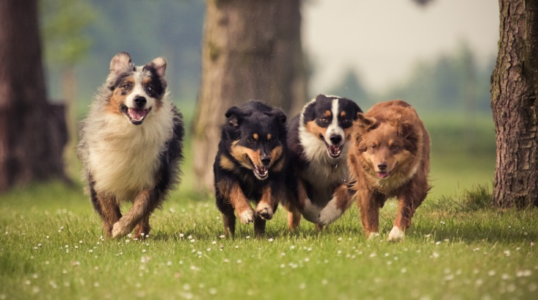
Australian Shepherds
Have a natural or docked bobtail
Possess blue, amber, hazel, brown or a combination eye color
Notes:
8

Slide 9
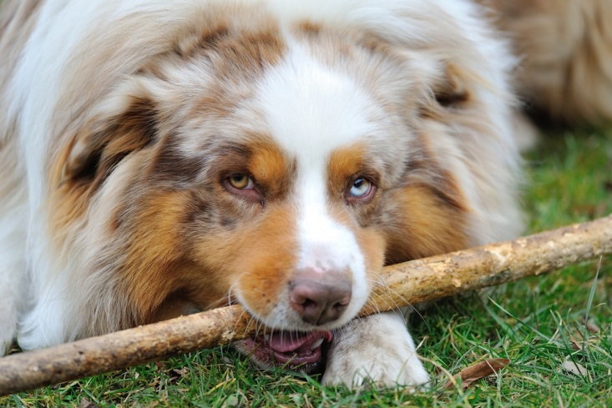
Australian Shepherd Behavior
Is characterized by the following:
intelligent
loyal
energetic
reserved with strangers
herding instinct
protective
Notes:
9

Slide 10
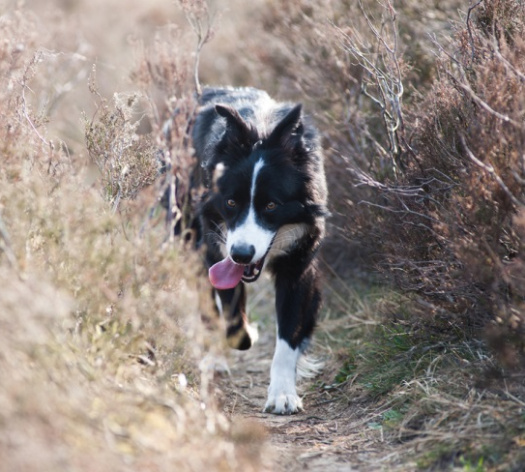
Border Collies
Weigh 30 to 45 pounds and measure 18 to 23 inches in height
Grow medium length hair which can be rough or smooth
Produce coats which are black, blue merle or sable color with white or tan markings
Notes:
10

Slide 11
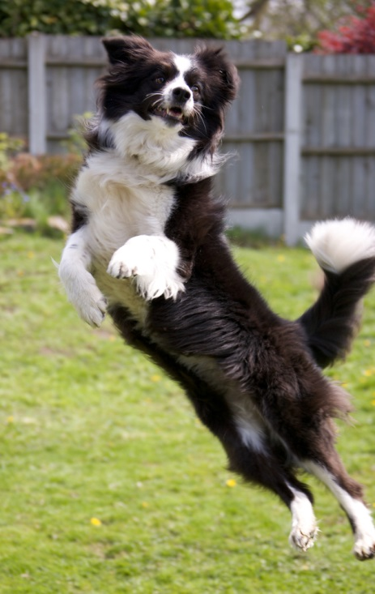
Border Collie Behavior
Is characterized by the following:
athletic
energetic
intelligent
devoted
high endurance
determined
Notes:
11

Slide 12
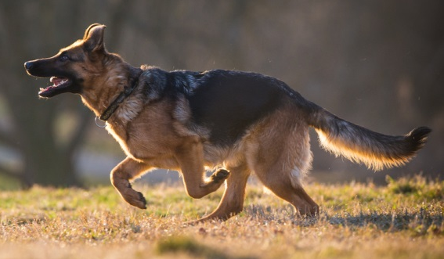
German Shepherds
Weigh 75 to 95 pounds and measure 22 to 26 inches in height
Grow straight, thick hair which is long and rough
Produce coats which are black, black and tan, black and cream, black and silver or sable in color
Are one of the most popular breeds in the world
Notes:
12

Slide 13
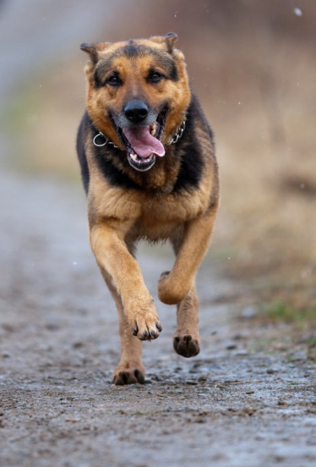
German Shepherd Behavior
Is characterized by the following:
adaptable
energetic
strong
high endurance
hard working
loyal
fearless
Notes:
13

Slide 14
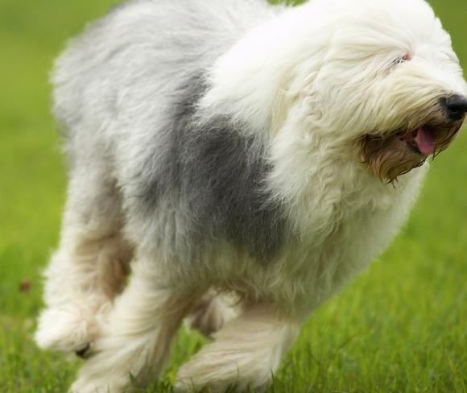
Old English Sheepdogs
Weigh 60 to 100 pounds and measure 21 inches in height
Grow thick and insulating hair
Produce coats which are gray, grizzle, blue or blue merle with or without white markings
Enjoy working with their owners in rural settings
Notes:
14

Slide 15
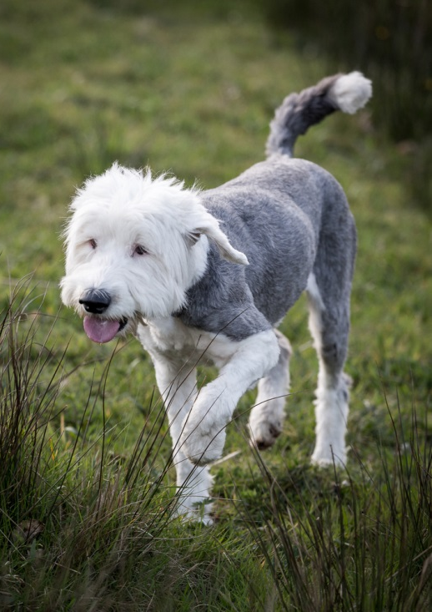
Old English Sheepdog Behavior
Is characterized by the following:
adaptable
energetic
strong
smart
gentle
intelligent
hard working
Notes:
15

Slide 16
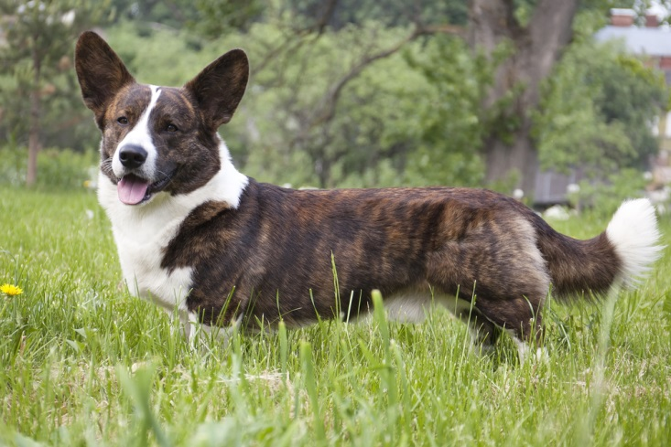
Welsh Corgi, Cardigans
Weigh 25 to 38 pounds and measure 10.5 to 12.5 inches in height
Grow straight, medium length hair which can be sable, red, brindle, black, blue merle, black and tan or black and brindle in color
May have white markings
Notes:
16

Slide 17
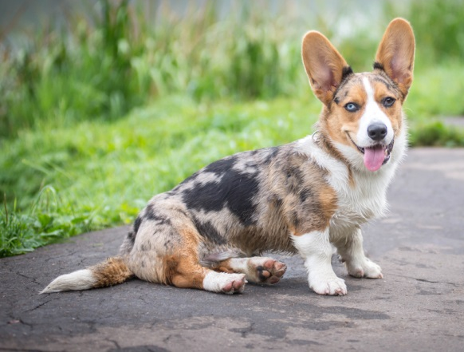
Welsh Corgi, Cardigans Behavior
Is characterized by the following:
strong
fast
loyal
affectionate
highly intelligent
courageous
devoted
aggressive toward other dogs
Notes:
17

Slide 18
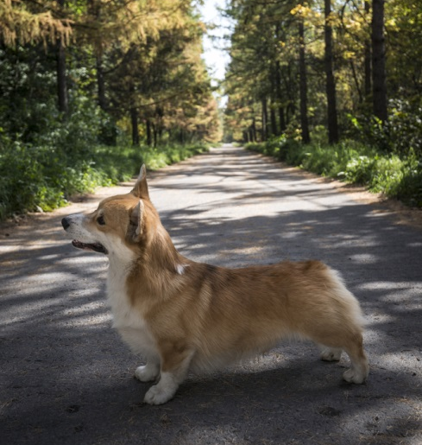
Welsh Corgi, Pembroke
Weigh 25 to 27 pounds and measure 10 to 12 inches in height
Grow straight, medium length hair which can be sable, fawn, red or black and tan in color
May or may not have white markings on coat
https://www.youtube.com/watch?v=f5KyMNDJE6o
Notes:
18

Slide 19
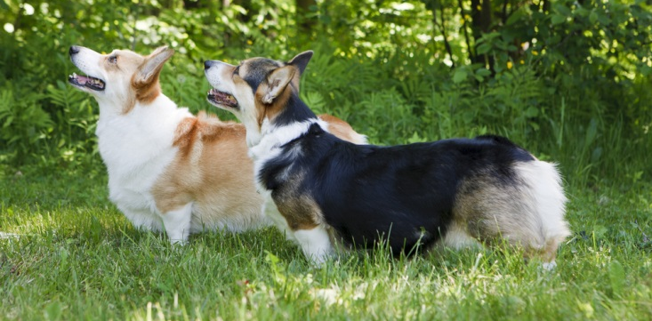
Welsh Corgi, Pembroke Behavior
Is characterized by the following:
athletic
dependable
loyal
obedient
devoted
outgoing
over protective of family and territory
Notes:
19

Slide 20
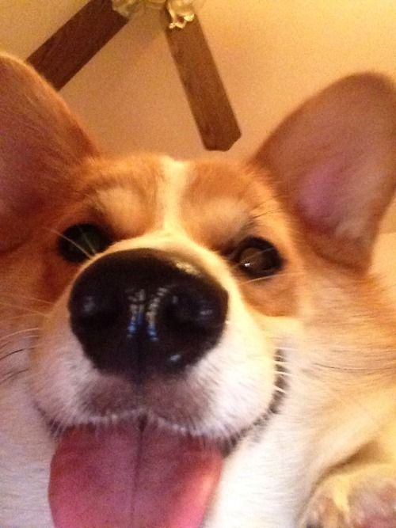
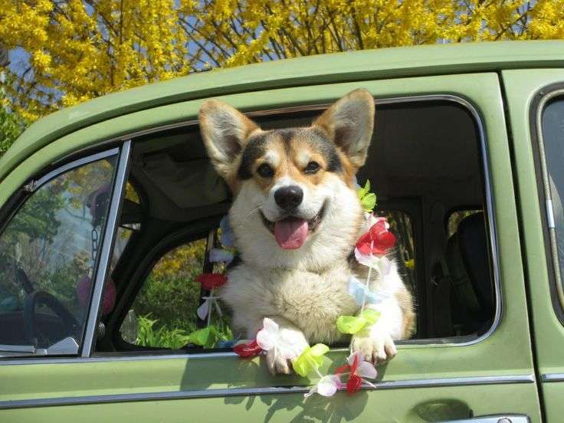
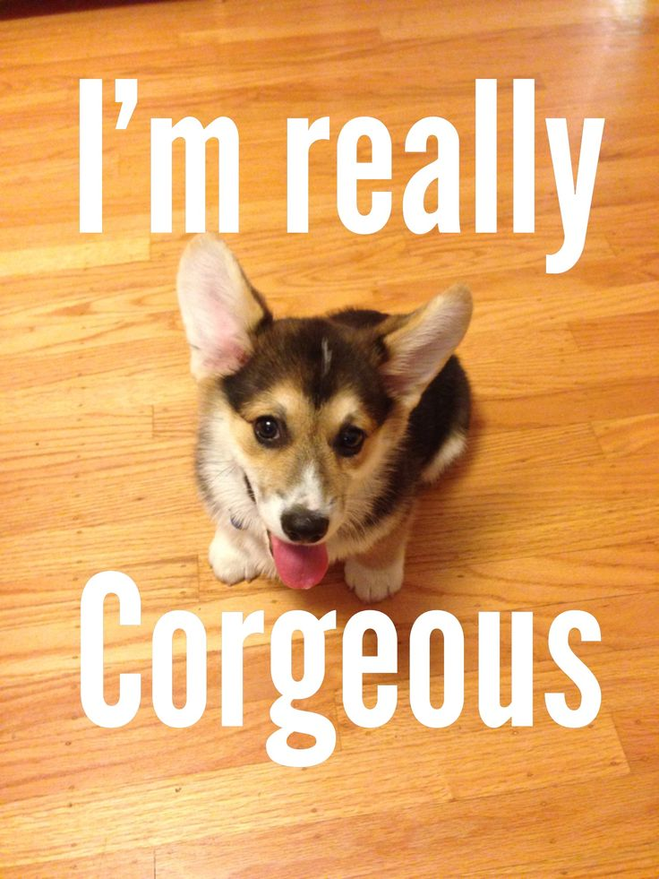
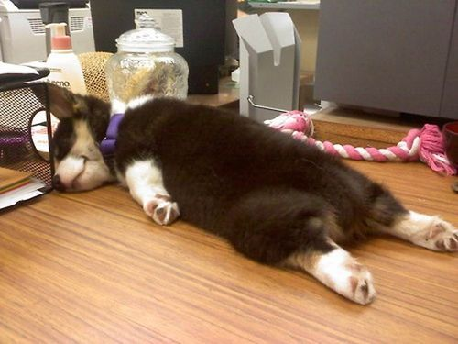
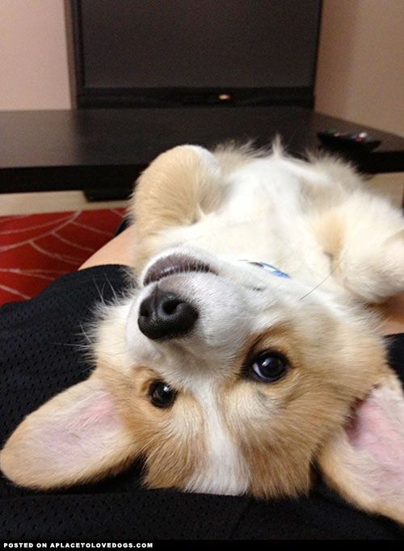
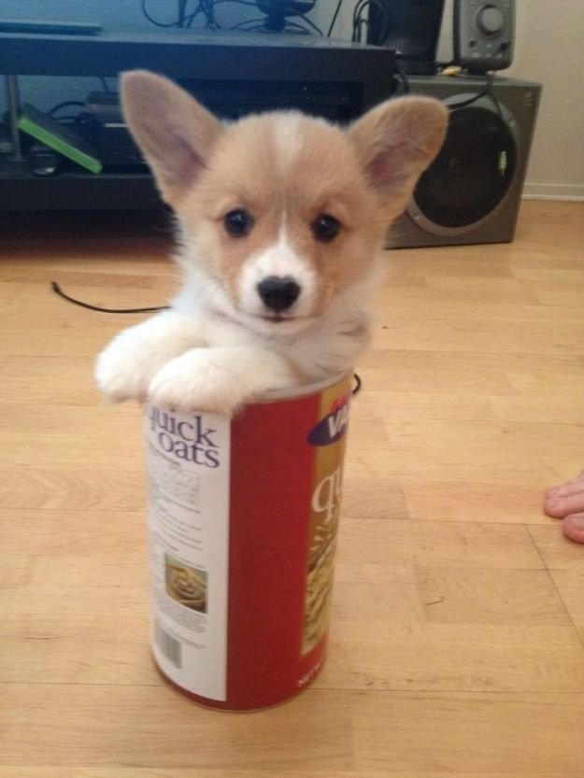
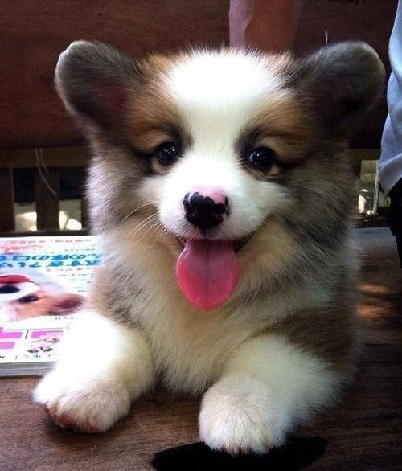
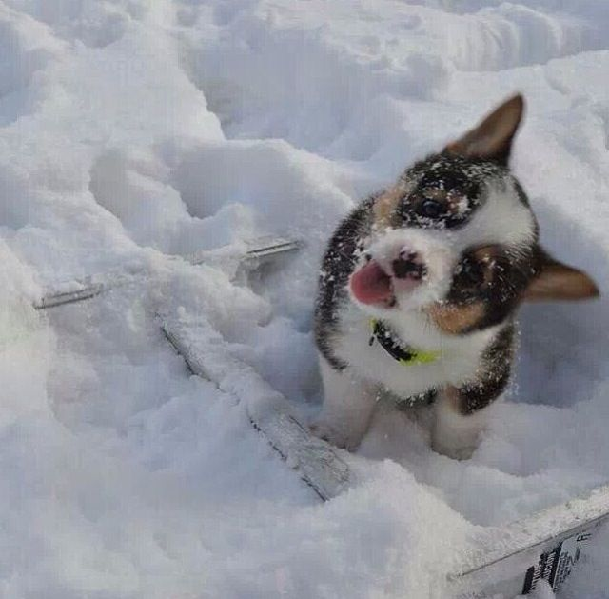

Slide 21
Breeds of Companion Animals: Dogs
Working Dogs

Slide 22
Working Dogs
Are bred to do work such as pull sleds, make water rescues and protect property
Include the following breeds:
Alaskan Malamute
Bernese Mountain Dog
Boxers
Doberman Pinscher
Mastiff
Rottweiler
Siberian Husky
Saint Bernard
Notes:
22

Slide 23
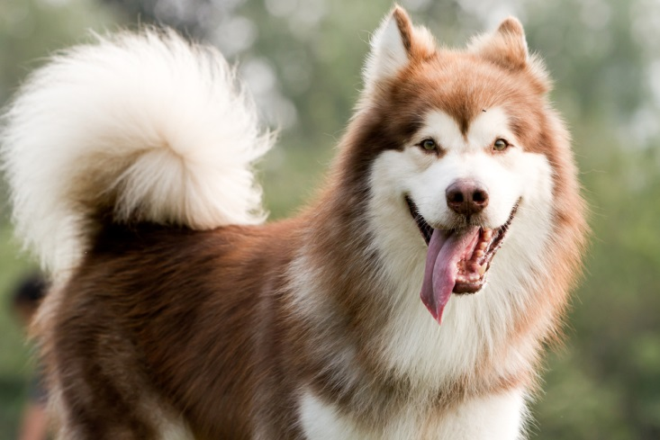
Alaskan Malamute
Males weigh 85 pounds and measure 25 inches in height
Females weigh 75 pounds and measure 23 inches in height
Grow thick and coarse coats with gray, white and other color combinations and marks

Slide 24
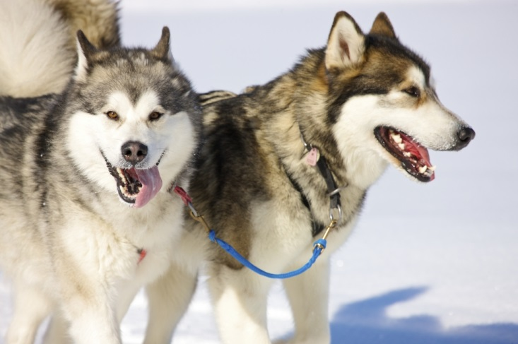
Alaskan Malamute Behavior
Is characterized by the following:
athletic
affectionate
loyal
playful
dignified
active
strong

Slide 25
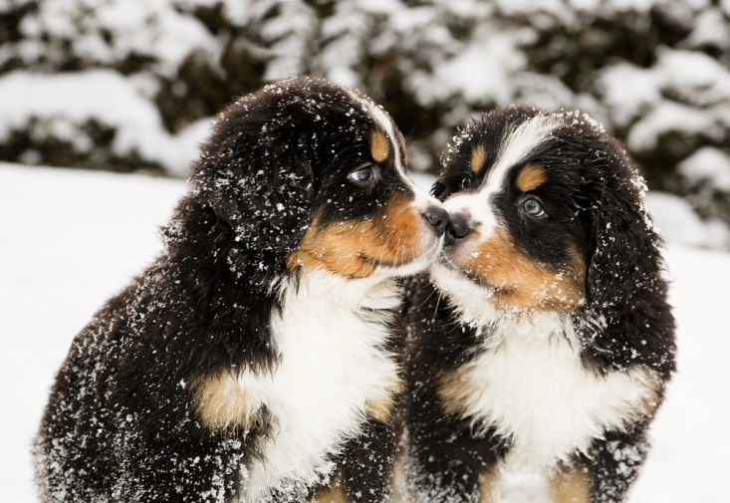
Burnese Mountain Dogs
Weigh 80 to 100 pounds and measure 23 to 28 inches in height
Grow a long silky coat which is tri-colored, with areas of black, rust and white

Slide 26
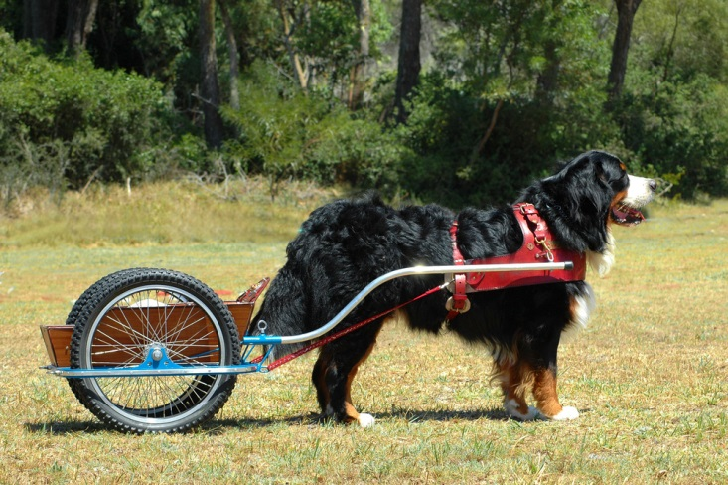
Burnese Mountain Dog Behavior
Is characterized by the following:
hardy
calm
inactive
good-natured
intelligence
strength
confident

Slide 27
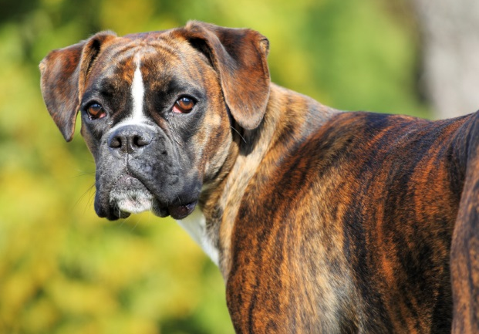
Boxer
Males weigh 65 to 80 pounds and measure 22 to 25 inches in height
Females weigh 50 to 65 pounds and measure 21to 24 inches in height
Grow short hair which is fawn and brindle colored
Notes:
27

Slide 28
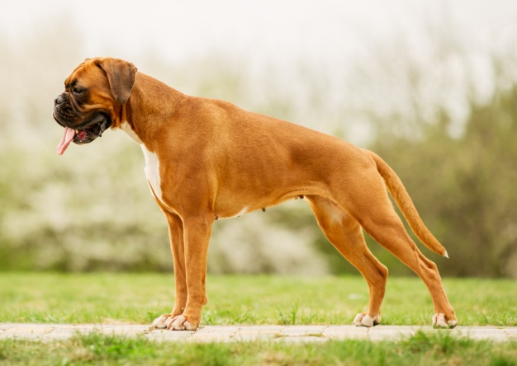
Boxer Behavior
Is characterized by the following:
loyal
strong
energetic
courageous
loving
intelligent
Notes:
28

Slide 29
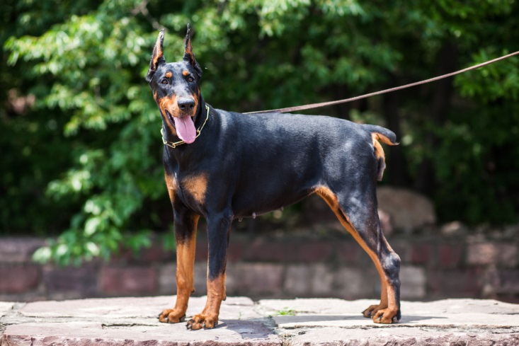
Doberman Pinschers
Weigh 66 to 88 pounds and measure 24 to 28 inches
Grow a short, shiny and hard coat which can be black, red, blue or fawn

Slide 30
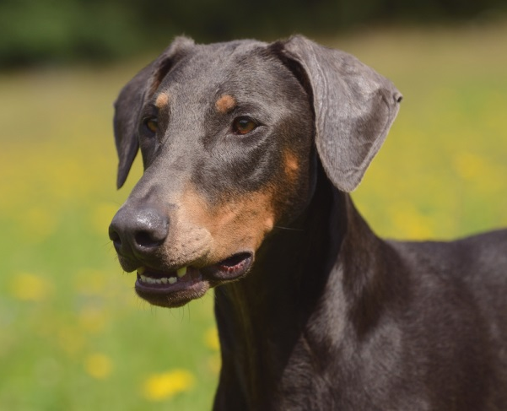
Doberman Pinscher Behavior
Is characterized by the following:
alert
fearless
loyal
trainable
active
energetic

Slide 31
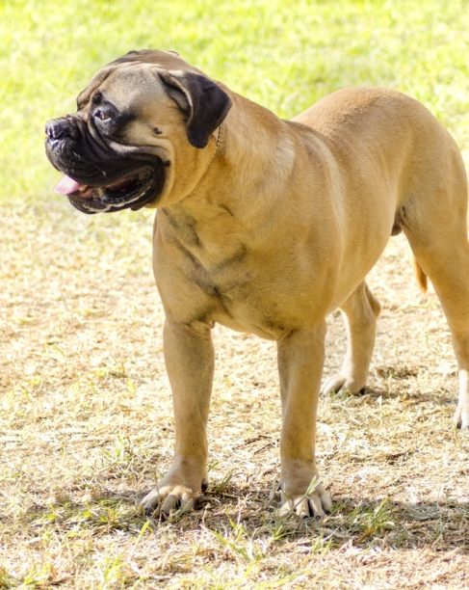
Mastiff
Males weigh 150 to 200 pounds and measure 30 inches
Females weigh 150 to 200 pounds and measure 27 inches
Grow a short coat which can be fawn, apricot or brindle

Slide 32
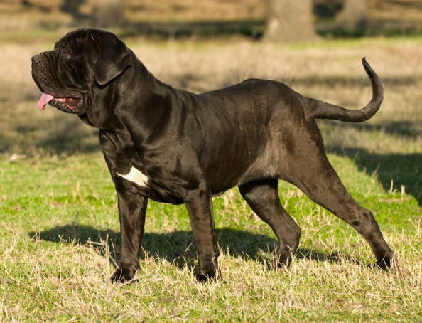
Mastiff Behavior
Include the following characteristics:
courageous
dignified
good-natured
docile
active
fearless

Slide 33
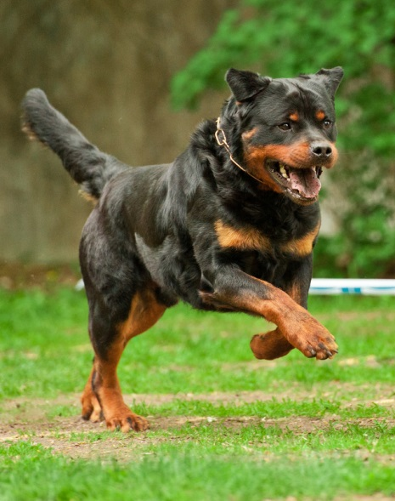
Rottweiler
Males weigh 85 to135 pounds and measure 24 to 27 inches in height
Females weigh 80 to 100 pounds and measure 22 to 25 inches in height
Grow short to medium length hair which is black with tan to bright rust colored markings
Notes:
33

Slide 34
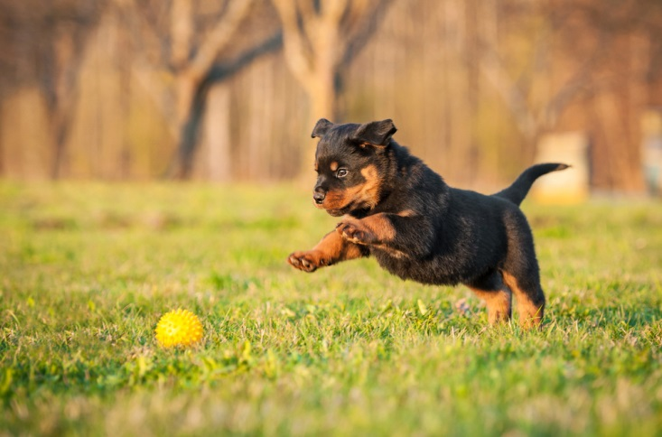
Rottweiler Behavior
Is characterized by the following:
dignified
slow to anger
natural guarding instincts
great courage
obedient
Notes:
34

Slide 35
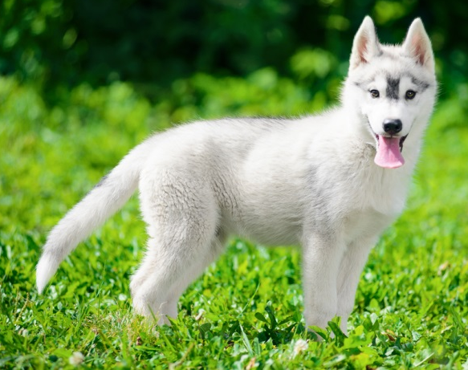
Siberian Huskies
Weigh 35 to 60 pounds and measure 20 to 23.5 inches in height
Grow a short to medium length double coat which can be any color of black to white
May have brown eyes, blue eyes, or one of each
Notes:
35

Slide 36
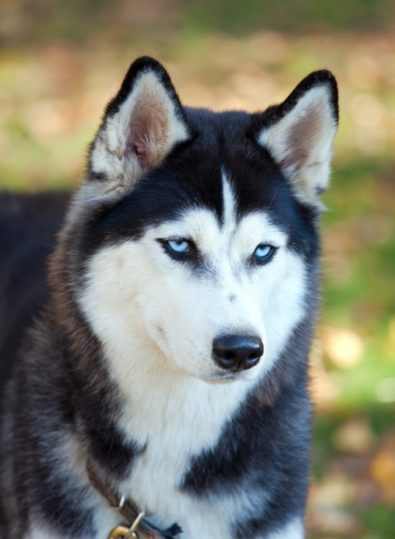
Siberian Husky Behavior
Is characterized by the following:
intelligent
eager to please
highly energetic
friendly to humans
Notes:
36

Slide 37
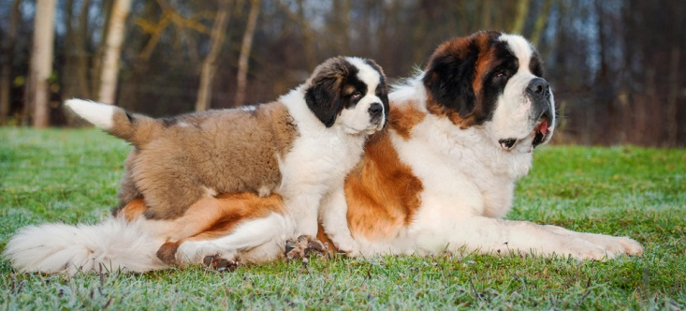
Saint Bernards
Weigh 110 to 200 pounds and measure 24 to 28 inches in height
Have both a rough and smooth variety
rough variety has a medium length double coat straight or slightly wavy
smooth variety has a dense double coat which is short
May be red with white markings or white with red markings
Notes:
37

Slide 38
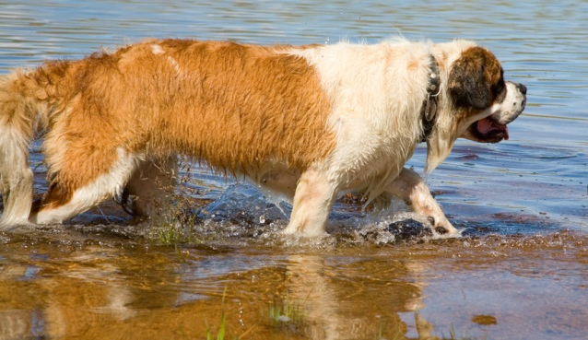
Saint Bernard Behavior
Is characterized by the following:
gentle
tolerant
does not fawn over strangers
excessively shy
may bite out of fear
Notes:
38

Slide 39
Breeds of Companion Animals: Dogs
Hound Dogs

Slide 40
Hound Dogs
Are bred with a good sense of smell, high stamina and hunting performance
Include the following breeds:
Afghan Hound
Basenji
Beagle
Bloodhound
Dachshund
Greyhound
Rhodesian Ridgeback
Whippet
Notes:
40

Slide 41
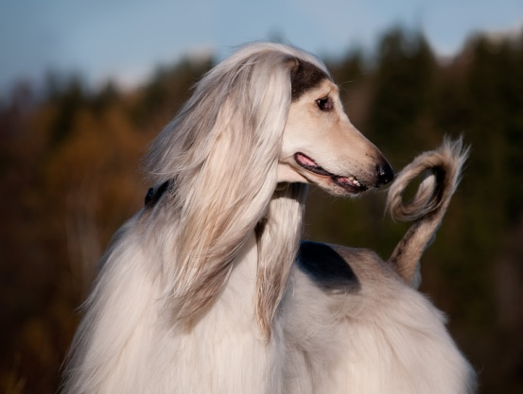
Afghan Hounds
Weigh 50 to 60 pounds and measure 25 to 27 inches in height
Grow long hair which comes in a variety of colors and patterns
Are one of the oldest known breeds, pre-dating written history

Slide 42
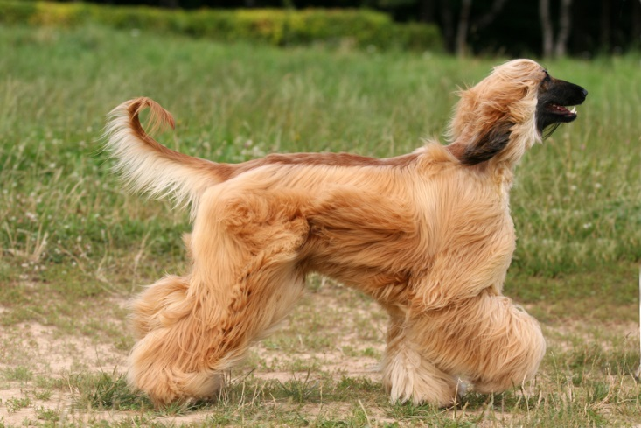
Afghan Hound Behavior
Is characterized by the following:
very active
fast
charming
independent
dignified
aloof

Slide 43
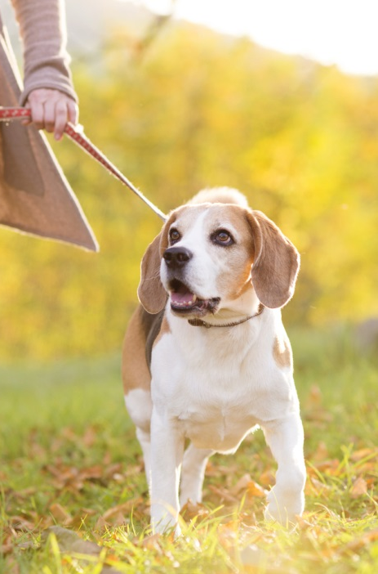
Beagles
Weigh 18- to 30 pounds and measure 13 inches in height
Grow medium length hair which can be red, black and white in color
Have long hanging ears
Notes:
43

Slide 44
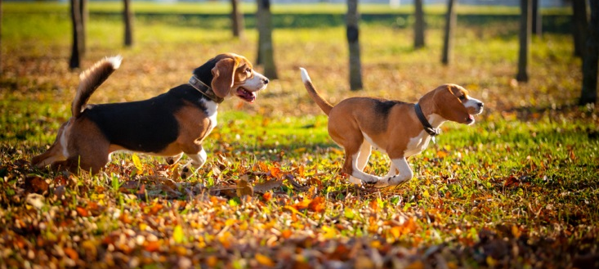
Beagle Behavior
Is characterized by the following:
intelligent
energetic
even tempered
eager to please
great companion for children
Notes:
44

Slide 45
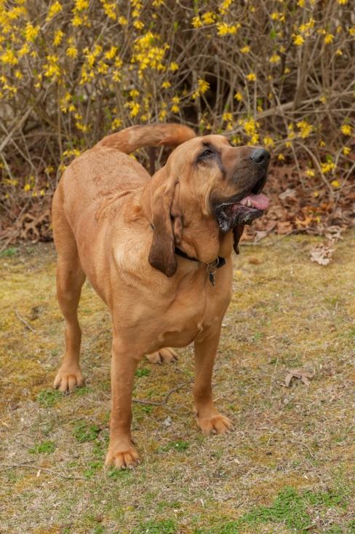
Bloodhounds
Weigh 80 to110 pound and measure 23 to 27 inches in height
Grow short, smooth, glossy hair which can be black and tan, red and tan or tawny
Have long, hanging ears, loose folds of skin on the head and neck and drooping eyes
Notes:
45

Slide 46
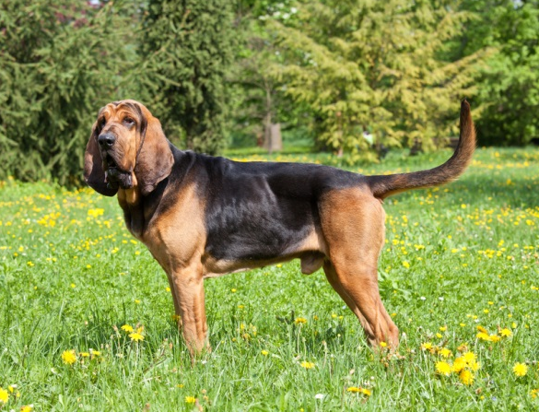
Bloodhound Behavior
Is characterized by the following:
friendly
active
stubborn
not suitable for city life
Notes:
46

Slide 47
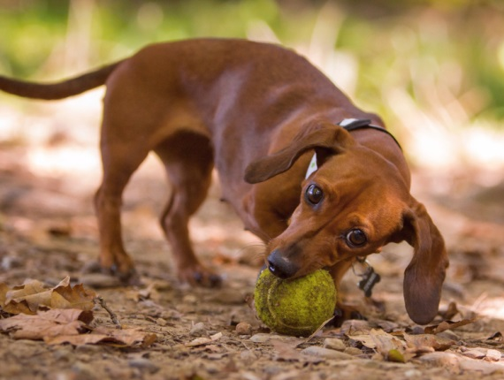
Dachshunds
Weigh 11 to 32 pounds and measure 5 to 9 inches in height
Come in the following three varieties depending on their coat:
wirehaired
smooth haired
longhaired
Grow red, sable, cream, black and tan, chocolate and tan, fawn and tan or brindle colored hair
Notes:
47

Slide 48
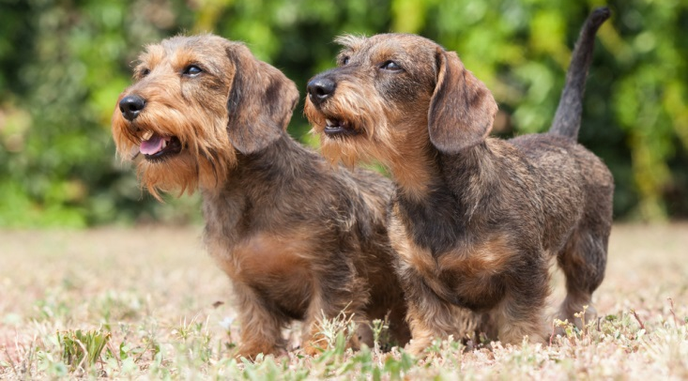
Dachshund Behavior
Is characterized by the following:
friendly
outgoing
lively
does not do well with small children
Notes:
48

Slide 49
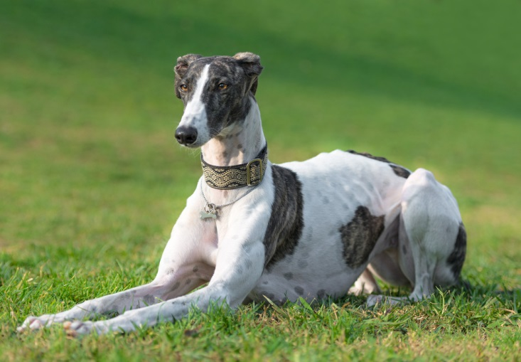
Greyhound
Weigh 60 to 70 pounds and measure 28 to 30 inches
Grow a short and smooth coat which can be any color including black, fawn and red

Slide 50
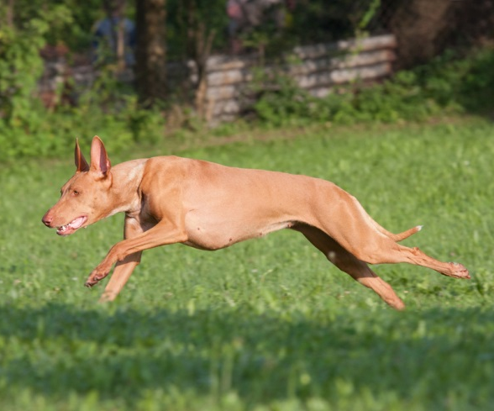
Greyhound Behavior
Is characterized by the following:
independent
gentle
noble
calm
athletic

Slide 51
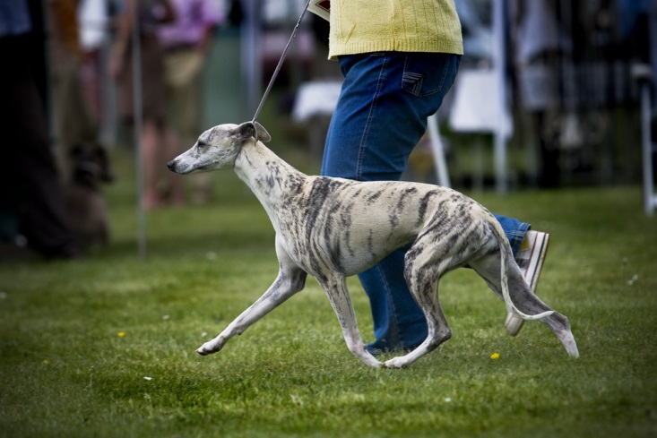
Whippets
Weigh 15 to 30 pounds and measure 18 to 22 inches
Grow a short and smooth coat which comes in a wide variety of colors and markings

Slide 52

Whippet Behavior
Is characterized by the following:
calm
affectionate
playful
active
sporadic energy

Slide 53
Breeds of Companion Animals: Dogs
Sporting Dogs

Slide 54
Sporting Dogs
Are bred for their natural instinct in water and woods, which allow them to be great hunting and field activity dogs
Include the following breeds:
Brittany
Cocker Spaniel (American)
Golden Retriever
Irish Setter
Labrador Retriever
Pointer
Vizsla
Weimaraner
Notes:
54

Slide 55

Brittanies
Weigh 28 to 33 pounds and measure 18 to 21 inches in height
Grow dense and wavy hair which can be dark orange and white or liver and white
May have white or roan color patches while no black is permitted
Notes:
55

Slide 56

Brittany Behavior
Is characterized by the following:
tend to be a one person dog
good with children
fearless and aggressive in field activities
reserved with strangers
Notes:
56

Slide 57

Cocker Spaniels (American)
Weigh 24 to 30 pounds and measure 14 to 15 inches in height
Grow a silky, flat or wavy coat which can come in a variety of mostly solid colors
Were traditionally known as excellent hunters

Slide 58

Cocker Spaniel behavior
Is characterized by the following:
happy
smart
gentle
very active
playful
loving

Slide 59

Golden Retrievers
Weigh 65 to 75 pounds and measure 23 to 24 inches in height in males
Weigh 55 to 65 pounds and measure 21 to 34 inches in height in females
Grow long, wavy or straight hair which is longer on the tail and legs than the torso
Can be various shades of cream to gold in color
Notes:
59

Slide 60

Golden Retriever Behavior
Is characterized by the following:
energetic
polite
friendly
devoted
eager to please
gentle and patient with children
Notes:
60

Slide 61

Irish Setters
Weigh 60 to 70 pounds and measure 25 to 27 inches in height
Grow long, silky hair which can be red or white, or a combination
Are known for a clown-like personality popular with families

Slide 62

Irish Setter Behavior
Is characterized by the following:
outgoing
sweet-natured
very active
trainable
loving

Slide 63

Labrador Retrievers
Males weigh 65 to 80 pounds and measure 22 to 25 inches in height
Females weigh 55 to 70 pounds and measure 21 to 24 inches in height
Grow straight, short hair which can be solid black, yellow or chocolate in color
Notes:
63

Slide 64

Labrador Retriever Behavior
Is characterized by the following:
strong
athletic
outgoing
intelligent
loyal
great with children
Notes:
64

Slide 65

Pointers
Weigh 44 to 75 pounds and measure 23 to 28 inches in height
Grow a short and dense coat which can be liver, lemon, black, orange or a variety of combinations with white or another solid color
First appeared in England around 1650

Slide 66

Pointer Behavior
Is characterized by the following:
even-tempered
alert
hardworking
very active
energetic
loyal

Slide 67

Weimaraners
Weigh 55 to 82 pounds and measure 23 to 27 inches in height
Grow a short sleek coat which should almost come in a silver-grey color
Are traditionally known as “gray ghosts” for their unique coat color

Slide 68

Weimaraner Behavior
Is characterized by the following:
friendly
alert
fearless
obedient
very active
athletic

Slide 69
Breeds of Companion Animals: Dogs
Non-Sporting Dogs

Slide 70
Non-Sporting Dogs
Are dogs which lack the qualities and characteristics of a hunting dog
Include the following breeds:
Bichon Frisé
Boston Terrier
Bulldog
Chow Chow
Dalmatian
Lhasa Apso
Poodle (Standard)
Shiba Inu
Notes:
70

Slide 71

Boston Terriers
Weigh 10 to 25 pounds and measure 15 to 17 inches in height
Grow short, fine hair which can be brindle, seal or black in color
May have various markings on the face, neck and legs
Notes:
71

Slide 72

Boston Terrier Behavior
Is characterized by the following:
lively
playful
intelligent
affectionate
loyal
Notes:
72

Slide 73

Bulldogs
Weigh 40 to 50 pounds and measure 12 to 15 inches in height
Grow short, fine hair which can be brindle, white, red or fawn in color
Has a large head, short face and round cheeks
Notes:
73

Slide 74

Bulldog Behavior
Is characterized by the following:
strong
kind
courageous
loyal
gentle
affectionate
Notes:
74

Slide 75

Chow Chow
Weigh 40 to 70 pounds and measure 15 to 17 inches in height
Grow thick, lion-like coats which come in five colors – red, black, blue, cinnamon and cream

Slide 76

Chow Chow Behavior
Is characterized by the following:
affectionate
devoted
cat-like
independent
stubborn
active

Slide 77

Dalmatians
Weigh 40 to 60 pounds and measure 19 to 24 inches in height
Grow short, smooth white hair with black dots
Are born completely white and grow spots later in life
Notes:
77

Slide 78

Dalmatian Behavior
Is characterized by the following:
energetic
bold
social
sensitive
loyal
Notes:
78

Slide 79

Poodles
Weigh 45-65 pounds and measure 15-21 inches in height
Grow dense, curly or corded hair
May be silver, cream, gray, blue, black, white, apricot, red or brown in color
Notes:
79

Slide 80

Poodle Behavior
Is characterized by the following:
athletic
playful
intelligent
lively
devoted
Notes:
80

Slide 81

Shiba Inu
Weigh 17 to 23 pounds and measure 13 to 17 inches in height
Grow plush coats which can be black and tan, red or red sesame.

Slide 82

Shiba Inu Behavior
Is characterized by the following:
alert
active
attentive
playful
sturdy
confident

Slide 83
Breeds of Companion Animals: Dogs
Terrier Dogs

Slide 84
Terrier Dogs
Are traditionally bred to hunt
Include the following breeds:
Airedale
Border
Carin
Jack Russell
Norwich
Rat Terrier
Scottish
West Highland White
Notes:
84

Slide 85

Airedales
Weigh 40 to 65 pounds and measure 20 to 23 inches in height
Grow a dense and wiry coat which can be both tan and black or a combination of the two

Slide 86

Airedale Behavior
Is characterized by the following:
clever
confident
proud
friendly
courageous
very active
spirited

Slide 87

Borders
Weigh 11 to 16 pounds and measure 11 to 16 inches in height
Grow a wiry coat which can be red, grizzle and tan

Slide 88

Border Behavior
Is characterized by the following:
very active
plucky
happy
affectionate
quick
agile
curious

Slide 89

Jack Russells
Weigh 13 to 17 pounds and measure 12 to 14 inches in height
Grow short to medium length hair
Are mostly white with tan, black or brown markings
Notes:
89

Slide 90

Jack Russell Terrier Behavior
Is characterized by the following:
outgoing
fearless
loving
devoted
energetic
courageous
Notes:
90

Slide 91

Rat Terriers
Weigh 12 to 35 pounds and measure 14 to 23 inches in height
Grow very short hair
May be red and white, tri-spotted, solid red, black and tan, blue and white or red brindle colored
Notes:
91

Slide 92

Rat Terrier Behavior
Is characterized by the following:
energetic
fearless
stubborn
fast
alert
Notes:
92

Slide 93

Scottish
Weigh 18 to 22 pounds and measure 10 inches in height
Grow a hard, wiry and weather resistant coat which can be black, brindle or wheaten

Slide 94

Scottish Behavior
Is characterized by the following:
active
independent
confident
social
spirited
dignified
curious
happy

Slide 95

West Highland Whites
Weigh 13 to 22 pounds and measure nine to 12 inches in height
Grow a thick double coat which is almost always white

Slide 96

West Highland White Behavior
Is characterized by the following:
very active
smart
loyal
entertaining
quick
curious
lively

Slide 97
Breeds of Companion Animals: Dogs
Toy Dogs

Slide 98
Toy Dogs
Are bred for their small size and companionship
Include the following breeds:
Brussels Griffon
Chihuahua
Maltese
Papillon
Pomeranian
Pug
Shih Tzu
Yorkshire Terrier
Notes:
98

Slide 99

Chihuahuas
Weigh 2 to 6 pounds and measure 6 to 9 inches in height
Come in two breeds:
short haired
long haired
May be solid brown, fawn, black or white
May include splashes of color or may be tri-colored
Notes:
99

Slide 100

Chihuahua Behavior
Is characterized by the following:
energetic
graceful
loyal
protective
loving
Notes:
100

Slide 101

Malteses
Weigh 4 to 7 pounds and measure 9 to 10 inches in height
Grow long, silky hair
Are completely white in color
Notes:
101

Slide 102

Maltese Behavior
Is characterized by the following:
well mannered
affectionate
intelligent
playful
obedient
Notes:
102

Slide 103

Papillons
Weigh 9 to 10 pounds and measure 8 to 11 inches in height
Grow long, silky hair
Are white with patches of any color
Notes:
103

Slide 104

Papillon Behavior
Is characterized by the following:
playful
elegant
intelligent
friendly
affectionate
obedient
Notes:
104

Slide 105

Pomeranians
Weigh 3 to 7 pounds and measure 8 to 11 inches in height
Grow long hair
May be any color with any pattern
Notes:
105

Slide 106

Pomeranian Behavior
Is characterized by the following:
lively
eager to learn
intelligent
loyal
affectionate
Notes:
106

Slide 107

Pugs
Weigh 14 to 18 pounds and measure 10 to 11 inches in height
Grow fine, short hair which can be silver, apricot-fawn or black
Have a tightly curled tail
Notes:
107

Slide 108

Pug Behavior
Is characterized by the following:
happy
playful
devoted
does extremely well with children
Notes:
108

Slide 109

Shih Tzus
Weigh 9 to16 pounds and measure 8 to 11 inches in height
Grow long, dense hair
Vary in color
Notes:
109

Slide 110

Shih Tzu Behavior
Is characterized by the following:
intelligent
active
happy
affectionate
easily spoiled
Notes:
110

Slide 111

Yorkshire Terriers
Weigh about 7 pounds and measure 8 to 9 inches in height
Grow fine, silky hair
May be blue and tan in color
Notes:
111

Slide 112

Yorkshire Terrier Behavior
Is characterized by the following:
playful
loyal
intelligent
affectionate
independent
fearless
Notes:
112

Slide 113
Breeds of Companion Animals: Dogs
ASSESSMENT
Notes:
113

Slide 114
Assessment
1. Which of the following is NOT a herding dog?
A. Brussels Griffon
B. Border Collie
C. German Shepard
D. Welsh Corgi, Cardigan
2. Which of the following is the accurate weight range for Australian Cattle Dogs?
A. 45 to 55 pounds
B. 75 to 100 pounds
C. 85 to 95 pounds
D. 35 to 45 pounds

Slide 115
Assessment
3. Which of the following does NOT describe German Shepard behavior?
A. Loyal
B. Hardworking
C. Fearful
D. Strong
4. Which of the following is the weight range of the Old English Sheepdog?
A. 70 to 100 pounds
B. 60 to 100 pounds
C. 50 to 70 pounds
D. 50 to 60 pounds

Slide 116
Assessment
5. Which of the following is NOT indicative of most Beagles?
A. Intelligent
B. Energetic
C. Inactive
D. Even-tempered
6. Which of the following hound dogs is unable to bark?
A. Bloodhounds
B. Beagles
C. Dachshund
D. Basenji

Slide 117
Assessment
7. Which of the following is NOT a breed of Dachshund?
A. Thick haired
B. Wirehaired
C. Smooth haired
D. Longhaired
8. Rhodesian Ridgebacks grow a short and dense coat in which of the following colors?
A. Light or blue wheaten
B. Blue
C. Red
D. Light or red wheaten

Slide 118
Assessment
9. Which of the following breeds grows a thick and puffy white coat?
A. Boston Terrier
B. Bichon Frisé
C. Dalmatian
D. Poodle
10. Which of the following is the weight range of the Bulldog?
A. 75 to 100 pounds
B. 30 to 50 pounds
C. 40 to 50 pounds
D. 90 to 100 pounds

Slide 119
Assessment
11. Which of the following is NOT indicative of Poodle behavior?
A. Playful
B. Bold
C. Shy
D. Social
12. Which of the following is NOT a color option for the Border
Terrier’s coat?
A. Black
B. Red
C. Tan
D. Grizzle

Slide 120
Assessment
13. Which of the following is the accurate weight range for Pugs?
A. 12 to 14 pounds
B. 18 to 24 pounds
C. 8 to 14 pounds
D. 14 to 18 pounds
14. Which of the following is NOT indicative of Pug behavior?
A. Happy
B. Playful
C. Aggressive
D. Bold

Slide 121
Assessment
15. Which of the following is the accurate height range for Shih Tzu's?
A. 6 to 11inches
B. 5 to 7 inches
C. 8 to 11 inches
D. 9 to 12 inches

Slide 122
Resources
Find Puppies for sale from trusted breeders . (n.d.). Puppies For Sale, Dogs For Sale From Trusted Dog Breeders. Retrieved July 2, 2014, from http://www.nextdaypets.com
Dogs. (n.d.). . Retrieved July 7, 2014, from http://www.pet-directory.net
Airedale Terrier Page. (n.d.). Airedale Terrier Page. Retrieved July 4, 2014, from https://www.akc.org/breeds/airedale_terrier/index.cfm
AKC Breeds by Group - Terrier Group. (n.d.). AKC Breeds by Group - Terrier Group. Retrieved July 3, 2014, from https://www.akc.org/breeds/terrier_group.cfm
AKC Breeds by Group - Toy Group. (n.d.). AKC Breeds by Group - Toy Group. Retrieved July 3, 2014, from https://www.akc.org/breeds/toy_group.cfm

Slide 123
Resources
AKC Breeds by Group - Hound Group. (n.d.). AKC Breeds by Group - Hound Group. Retrieved July 3, 2014, from http://www.akc.org/breeds/hound_group.cfm
AKC Breeds by Group - Working Group. (n.d.). AKC Breeds by Group - Working Group. Retrieved July 10, 2014, from http://www.akc.org/breeds/working_group.cfm
AKC Breeds by Group - Non-Sporting Group. (n.d.). AKC Breeds by Group - Non-Sporting Group. Retrieved July 10, 2014, from http://www.akc.org/breeds/non-sporting_group.cfm
AKC Breeds by Group - Herding Group. (n.d.). AKC Breeds by Group - Herding Group. Retrieved July 10, 2014, from http://www.akc.org/breeds/herding_group.cfm

Slide 124
Resources
AKC Breeds by Group - Miscellaneous Class. (n.d.). AKC Breeds by Group - Miscellaneous Class. Retrieved July 10, 2014, from http://www.akc.org/breeds/miscellaneous_class.cfm
AKC Breeds by Group - Sporting Group. (n.d.). AKC Breeds by Group - Sporting Group. Retrieved July 10, 2014, from http://www.akc.org/breeds/sporting_group.cfm
Dog Breeds. (n.d.). . Retrieved July 3, 2014, from http://www.woofipedia.com/discover/breeds

Slide 125
Acknowledgements
Executive Producer
Gordon W. Davis, Ph.D.
Production Coordinator
John L. Hawley
Graphic Designer
Melody Rowell
Technical Writer
Jessica Odom
V.P. of Brand Management
Clayton Franklin
© MMXIV
CEV Multimedia, Ltd.
Notes:
125

